Slide 1

DSA
Week 6
Recursion
Data Structures and Algorithms (DSA)
Prescribed Module/Elective
Diploma in IT, ISF, FI
Year 2 (2018/19), Semester 4

Slide 2
Topics
Introduction of Recursion
Constructing Recursive Solutions
A Poor Solution to a Simple Problem
Recursion in Array Processing
A Simple Solution to a Difficult Problem
Recursion and Efficiency
Recursion VS Iteration

Slide 3
References
1. Data Abstraction and Problem Solving with C++ 5th Edition
☞ chapter 2

Slide 4

1. What is Recursion?
Recursion is a extremely powerful programming technique employed to solve problems.
Breaks a problem into smaller but similar problem size which may be easier to solve
-> Divide and Conquer
At the end of the ‘division’ of the problem, you reach a smallest problem where by answer is trivial
Using that answer enables you to solve the previous problems

Slide 5
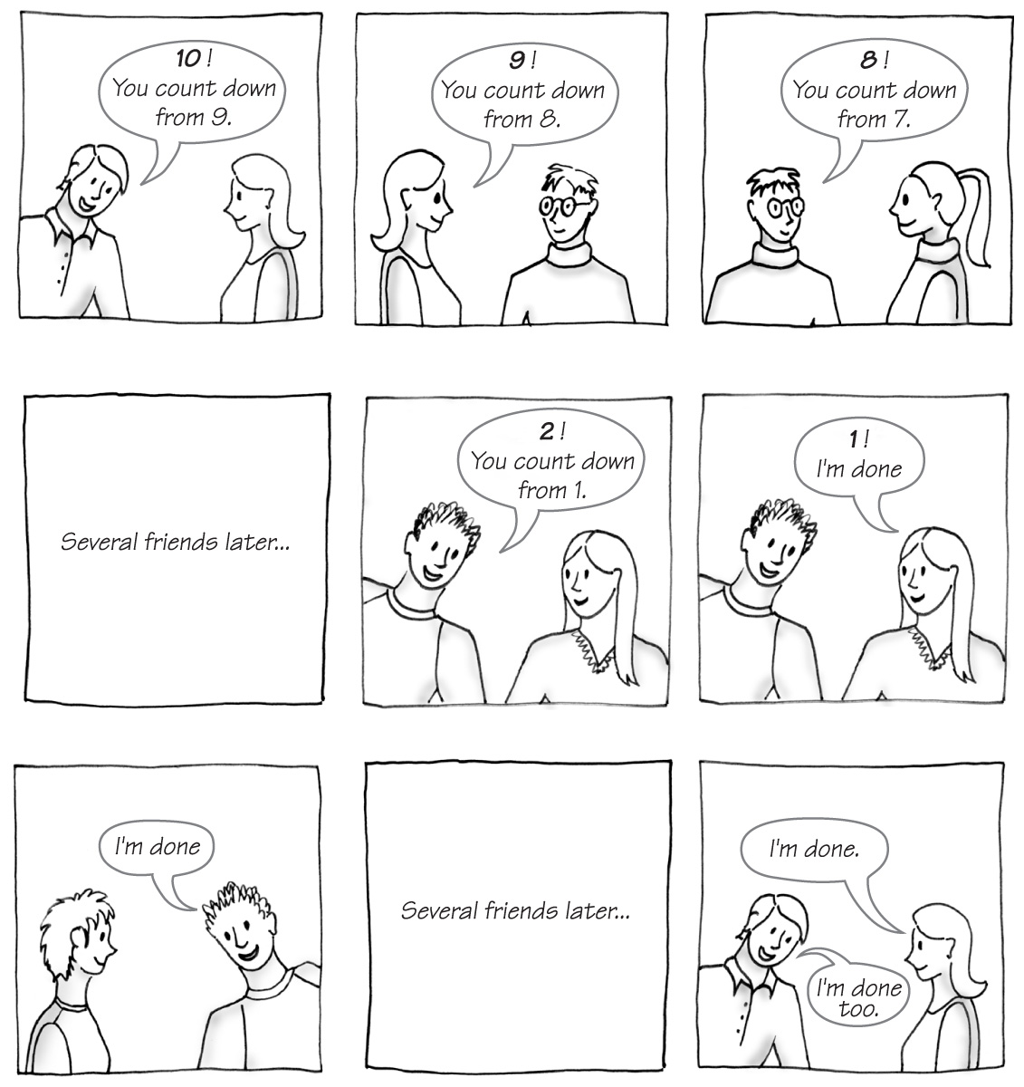
What is Recursion?
Carrano, Data Structures and Abstractions with Java, Second Edition, (c) 2007 Pearson Education, Inc. All rights reserved. 0-13-237045-X

Slide 6
What is Recursion?
In programming, recursion takes the form of a function that calls itself
-> Recursive function
int fac(int n) // compute the factorial of a number recursively
{
if (n == 0) // base case
return 1;
else // recursive step
return n * fac(n-1);
}
Each time function calls a copy of itself to work on smaller problem -> Recursive Call / Recursive Step

Slide 7
2. Constructing Recursive Solutions
4 Questions:
How to define the problem in terms of a smaller and similar problem?
Does each recursive call reduce size of problem?
What instance of the problem serve as base case?
As the problem size reduces, will you reach the base case?

Slide 8
Constructing Recursive Solutions
Structure of Recursive Function:
Function prototype must provide parameter(s)
Divides problem into 2 or more pieces
Division via selection control structures (if-else)
One piece that you know how to do
☞ Base case
The other piece(s) that you don’t know how to do yet
Take steps towards the base case to solve the problem
Recursion step usually includes a return
☞ Returns program control to caller to be combined with other pieces

Slide 9
Constructing Recursive Solutions
Problem : Compute the factorial of an integer n (n!)
Possible Iterative Definition:
factorial(n) = n * (n – 1) * (n – 2) * … * 1 (for n > 0)
factorial(0) = 1
int fac(int n) // iterative version
{
int result = 1;
for (int i = n; i >= 1; i--)
result = result * i;
return result;
}

Slide 10
Constructing Recursive Solutions
Problem : Compute the factorial of an integer n (n!)
Possible Recursive Definition:
1 if n = 0
n * factorial(n–1) if n > 0
factorial(n)
int fac(int n) // recursive version
{
if(n == 0)
return 1;
else
return n * fac(n-1);
}

Slide 11
Constructing Recursive Solutions
In fact, the expression of a factorial(n) in terms of factorial (n-1) is an example of Recurrence Relation in Mathematics.
Recurrence Relation:
A mathematical formula that generates the terms in a sequence from previous terms
Recurrence relation for factorial(n):
factorial(n) = n * [(n–1) * (n–2) * . . . * 1] = n * factorial(n–1)

Slide 12
Constructing Recursive Solutions
Writing Invariants:
Equally important as writing them for iterative functions
If precondition is violated, function would not behave correctly.
// pre: n >= 0.
// return The factorial of n
int fac(int n)
{
if(n == 0)
return 1;
else //Invariant: n > 0, so n-1 >= 0
//Thus fac(n-1) returns (n-1)!
return n * fac(n-1); // n * (n-1)! is n!
}
For the above example, there will be infinite recursive calls if precondition is violated because the function never reach the base case.

Slide 13
Constructing Recursive Solutions
Problem : Writing a String Backward
- Print the characters in a string in backward manner
Which of them works??
//stripping away last character
writeBackward(string s)
if (string is empty) // base case
do nothing
else // recursive step
{
write the last character of s
writeBackward(s minus its last character)
}
Notes:
This one works

Slide 14
Constructing Recursive Solutions
//stripping away first character
writeBackward1(string s)
if (string is empty)
do nothing
else
{
write the first character of s
writeBackward1(s minus its first character)
}
Download from MEL
Notes:
Works

Slide 15
Constructing Recursive Solutions
//stripping away first character
writeBackward2(string s)
if (string is empty)
do nothing – this is the base case
else
{
writeBackward2(s minus its first character)
write the first character of s
}
Download from MEL

Slide 16
3. A Poor Solution to Simple Problem - Fibonacci
Fibonacci Sequence
The first two numbers are 0 and 1
Successive numbers are the sum of the previous two
0, 1, 1, 2, 3, 5, 8, 13, 21, 34, ...
Recursive definition for Fibonacci:
n if n is 0 or 1
fibonacci(n – 1) + fibonacci(n – 2) if n > 2
fibonacci(n)

Slide 17
3. A Poor Solution to Simple Problem - Fibonacci
int fib(int n) // recursive version
{
if (n == 0 || n == 1)
return n;
else
return fib(n - 2) + fib(n - 1);
}

Slide 18
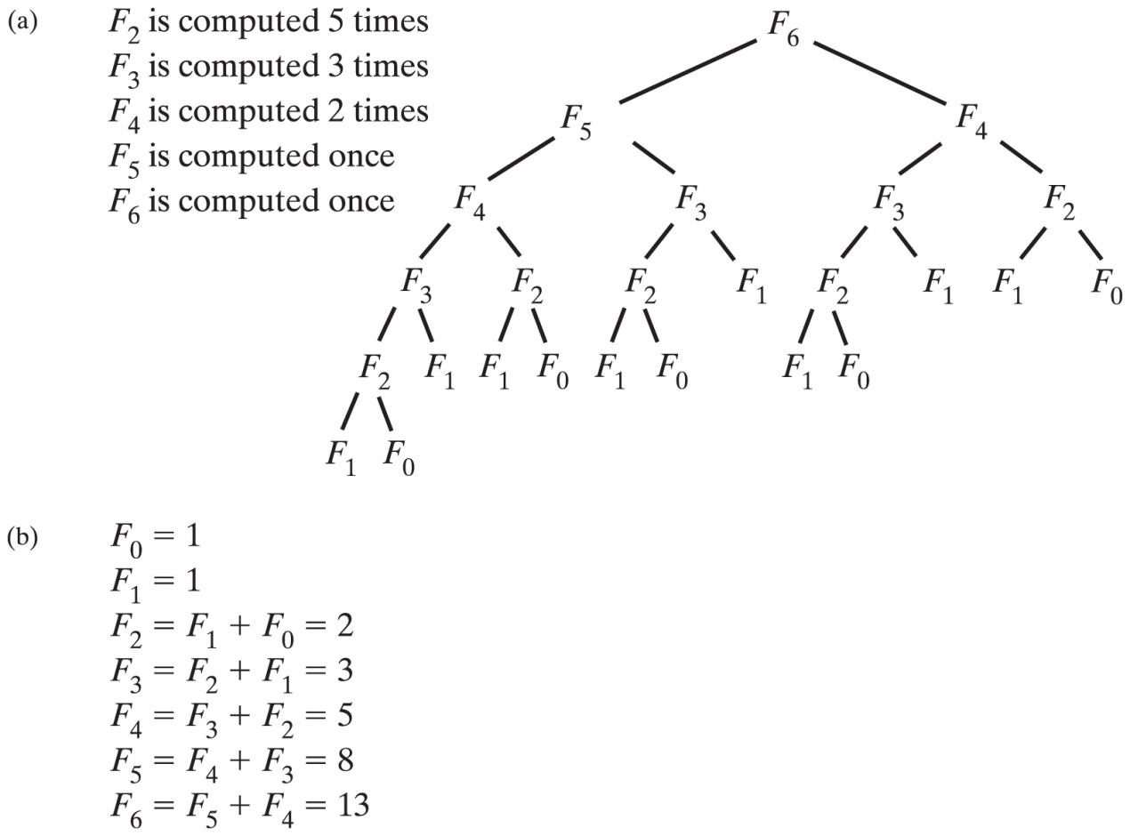
A Poor Solution to Simple Problem - Fibonacci
Download iterative and recursive algo from MEL
Time efficiency grows exponentially with n!
Carrano, Data Structures and Abstractions with Java, Second Edition, (c) 2007 Pearson Education, Inc. All rights reserved. 0-13-237045-X

Slide 19
4. Recursion in Array Processing
Recursive processing of an array:
Divide the array into two pieces repetitively
E.g. Searching for the maximum number in an array
Recursive Solution:
if (array has only one item)
maxArray(array) is the item in array
else if (array has more than one item)
maxArray(array) is the maximum of
maxArray(left half of array) and
maxArray(right half of arrray)

Slide 20
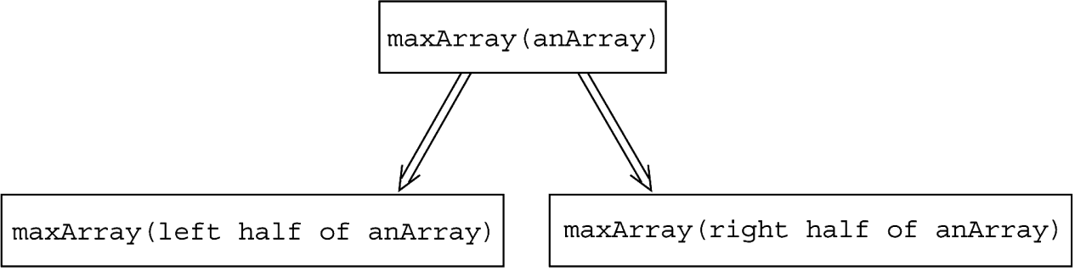
Recursion in Array Processing
Recursive processing of an array:
Copyright © 2007 Pearson Education, Inc. Publishing as Pearson Addison-Wesley. Ver. 5.0.

Slide 21
Recursion in Array Processing
How is the recursive solution different from Binary search?
Binary Search:
binarySearch(ItemType array[], ItemType target)
if (array is of size 1) // base case
Determine if array’s item is equal to target
else // recursive step
{
Find the midpoint of array
Determine which half of the array contains the target
if (target is in the first half of array) binarySearch(first half of array, target)
else
binarySearch(second half of array, target)
}
Binary search conquers only one of its subproblems at each step
Recursive solution for finding max whereas conquers both.
In addition, after recursive solution conquers the subproblems, it
must reconcile the two solutions (ie. Find max of the two
maxima)

Slide 22
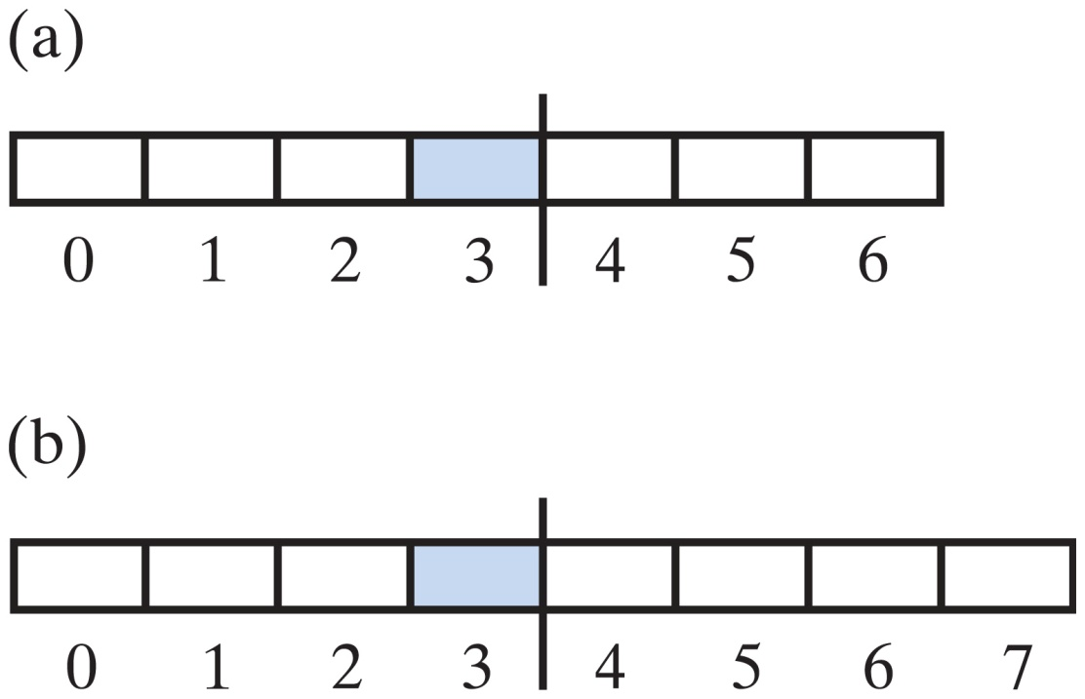
Recursion in Array Processing
Two arrays with middle elements within left halves
Carrano, Data Structures and Abstractions with Java, Second Edition, (c) 2007 Pearson Education, Inc. All rights reserved. 0-13-237045-X

Slide 23
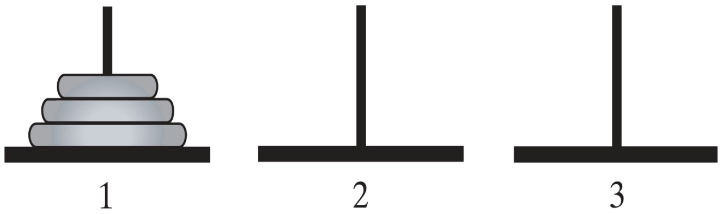
5. A Simple Solution to a Problem– Tower of Hanoi
Problem:
Tower of Hanoi -> https://www.youtube.com/watch?v=YstLjLCGmgg
Given n disks of different sizes and three poles 1, 2, 3,
how to move all the disks from 1 to 3, using pole 2 as a spare?
Carrano, Data Structures and Abstractions with Java, Second Edition, (c) 2007 Pearson Education, Inc. All rights reserved. 0-13-237045-X

Slide 24
A Simple Solution to a Problem– Tower of Hanoi
Rules for the Towers of Hanoi game
Only one disk can be moved at a time
Only the top disk can be moved
No disk can be placed on top of a smaller disk
Carrano, Data Structures and Abstractions with Java, Second Edition, (c) 2007 Pearson Education, Inc. All rights reserved. 0-13-237045-X
Notes:
Number of moves taken for 3 disks: 7
Formula for the number of moves taken for n disks: 2^{n}-1

Slide 25
A Simple Solution to a Problem – Tower of Hanoi
Major steps:
If only 1 disk (i.e. n = 1), move it from pole 1 to 3
If more than 1 disks (i.e. n > 1)
Ignore the bottom disk and solve the problem for n – 1 disks with the small modification that pole 2 is the destination and pole 3 is the spare
After the above, n – 1 disks will be on pole 2 and the largest disk is on pole 1. So solve the problem for n-1 by moving the largest disk from pole 1 to 3
Proceed to move the n-1 disks from pole 2 to pole 3,
i.e. solve the problem with pole 2 as the source, pole 3 as destination and pole 1 as spare.

Slide 26
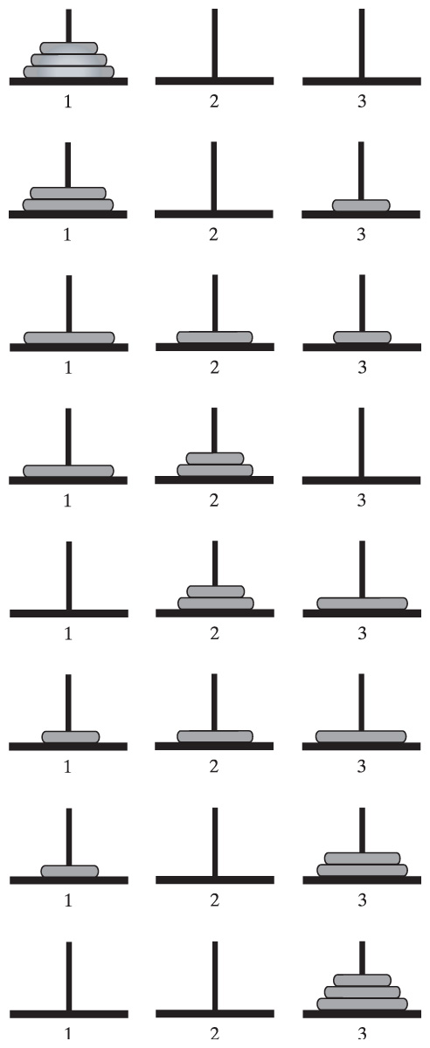
A Simple Solution to a Problem– Tower of Hanoi
Carrano, Data Structures and Abstractions with Java, Second Edition, (c) 2007 Pearson Education, Inc. All rights reserved. 0-13-237045-X

Slide 27
A Simple Solution to a Problem– Tower of Hanoi
See Tower of Hanoi Animation slides
Carrano, Data Structures and Abstractions with Java, Second Edition, (c) 2007 Pearson Education, Inc. All rights reserved. 0-13-237045-X

Slide 28
A Simple Solution to a Problem – Tower of Hanoi
Recursive solution for Tower of Hanoi
solveTowers(n, source, destination, spare)
{
if (n == 1)
cout << “move disk from “ << source << “ to “ << destination << endl;
else
{
solveTowers(n-1, source, spare, destination)
solveTowers(1, source, destination, spare)
solveTowers(n-1, spare, destination, source)
}
}
Try other number of discs:
https://www.youtube.com/watch?v=YstLjLCGmgg
http://towersofhanoi.info/Animate.aspx

Slide 29
6. Recursion and Efficiency
Factors that affects the efficiency of a recursive solution are:
Inherent inefficiency of the recursive solution
-> possibly due to recomputation of same values repetitively e.g. for fib (7), fib(3) is computed 5 times
Overhead associated with function calls
-> an initial call to function can generate a large number of recursive calls - magnify the cost in context switching
-> Need to store activation record in program stack for each recursive call (refer to Appendix A)

Slide 30
Recursion and Efficiency
Recursion is best suited for problems that are recursive in nature.
E.g. Tower of Hanoi, BST, MergeSort, QuickSort, Games
However some recursive solutions can be very inefficient and should not be used.
E.g. fibonnaci
In general, recursion should be used only if there is no simple iterative solution to the problem

Slide 31
Recursion vs Iteration
Iteration | Recursion
Repetition control structure | Selection control structure
Involve repetition | Involve repetition
Achieves repetition through repetition control structure | Achieves repetition through repetitive function calls
Terminates when loop continuation condition is false | Terminates when base case is reached.
Mechanism involves constant modification of counter | Mechanism involves divide and conquer
Infinite iteration when loop continuation condition is always true | Infinite Recursion when problem is not reduced in such way that converges on the base case

Slide 32
Summary
Introduction of Recursion
Constructing Recursive Solutions
A Poor Solution to a Simple Problem
Recursion in Array Processing
A Simple Solution to a Difficult Problem
Recursion and Efficiency
Recursion vs Iteration

Slide 33
Appendix 1 - Tracing a Recursive Function
A Box Trace/ Activation Record consists of:
Input parameters into the function
Local variables in the function
Placeholder for the value returned by each recursive call from the current box
Return value of the function
facv(3):
n = 3
return 3 * fac(2)

Slide 34
Tracing a Recursive Function
A box trace is a systematic way to trace the actions of a recursive function, very useful for debugging recursive functions.
Corresponds to an activation record
Contains a function’s local environment/ context at the time of and result of call to the function.
When a call is made to a function, we say the context/ local environment of current function is switched to new one.
During context switching, previous context must be saved (onto a stack) so that it can be reinstated upon return from function call.

Slide 35
Tracing a Recursive Function
Example
int fac(int n) // fac (short form for factorial)
{
if (n == 0)
return 1;
else
return n * fac(n-1);
}
fac(1):
n = 1
return 1 * fac(0)
fac(2):
n = 2
return 2 * fac(1)
fac(2):
n = 2
return 2 * fac(1)
fac(3):
n = 3
return 3 * fac(2)
fac(3):
n = 3
return 3 * fac(2)
fac(3):
n = 3
return 3 * fac(2)

Slide 36
Tracing a Recursive Function
fac(0):
n = 0
return 1
fac(1):
n = 1
return 1 * fac(0)
fac(1):
n = 1
return 1 * 1 = 1
fac(2):
n = 2
return 2 * fac(1)
fac(2):
n = 2
return 2 * fac(1)
fac(2):
n = 2
return 2 * 1 = 2
fac(3):
n = 3
return 3 * fac(2)
fac(3):
n = 3
return 3 * fac(2)
fac(3):
n = 3
return 3 * fac(2)
fac(3):
n = 3
return 3 * 2 = 6

